Slide 1
Introduction to Hadoop Components Vigneswara Reddy Tupakula

Slide 2
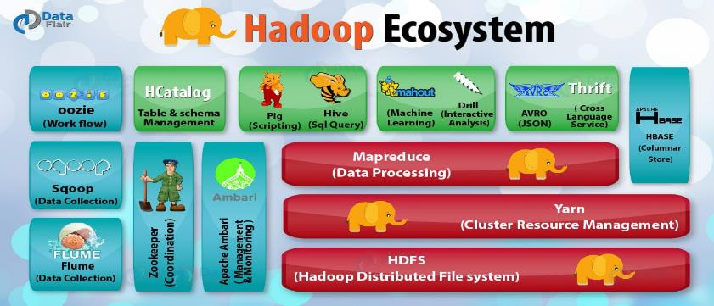
Hadoop Eco – System Hadoop framework is based on a simple programming model (MapReduce) and it enables a computing solution that is scalable, flexible, fault-tolerant and cost effective.

Slide 3
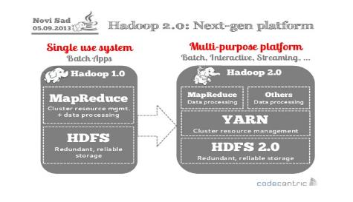
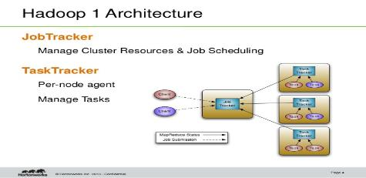
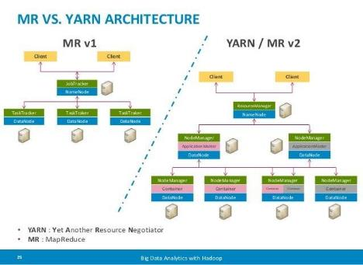
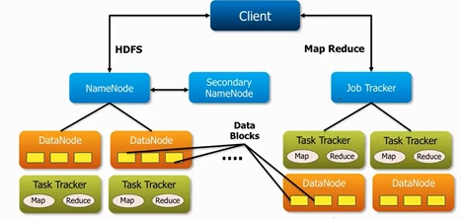

Slide 4
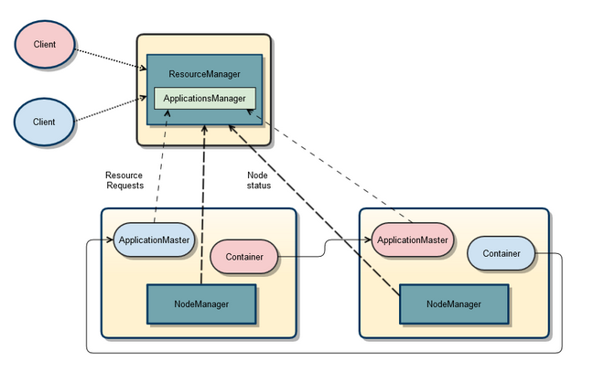
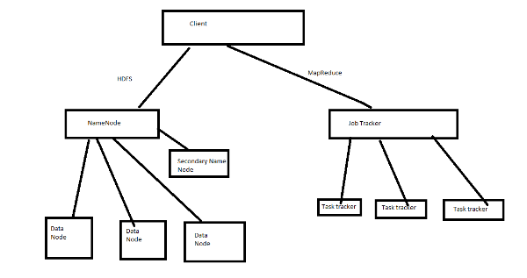

Slide 5
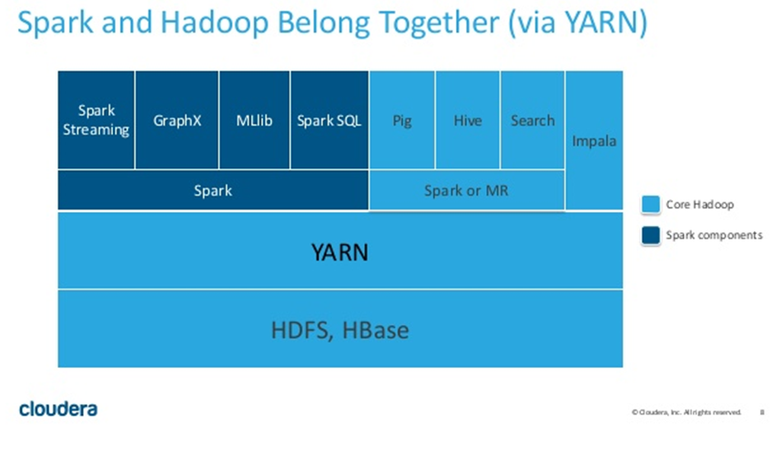
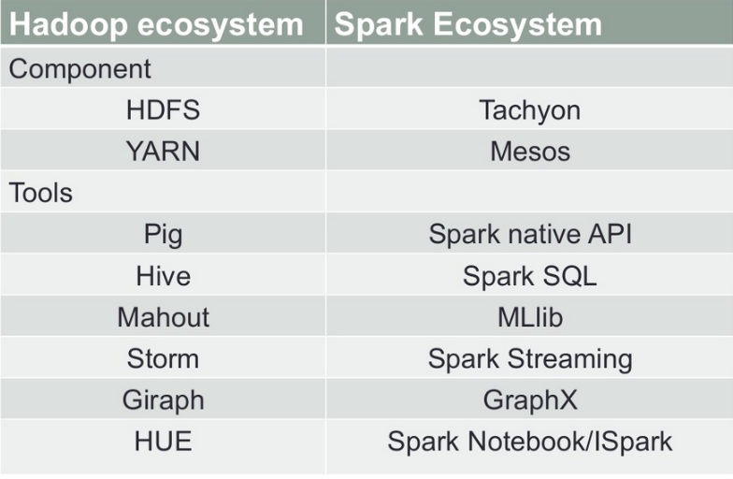
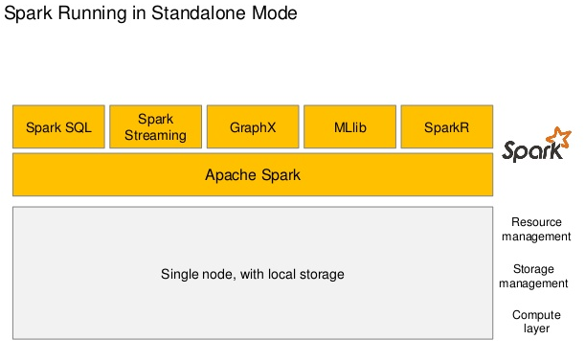

Slide 6
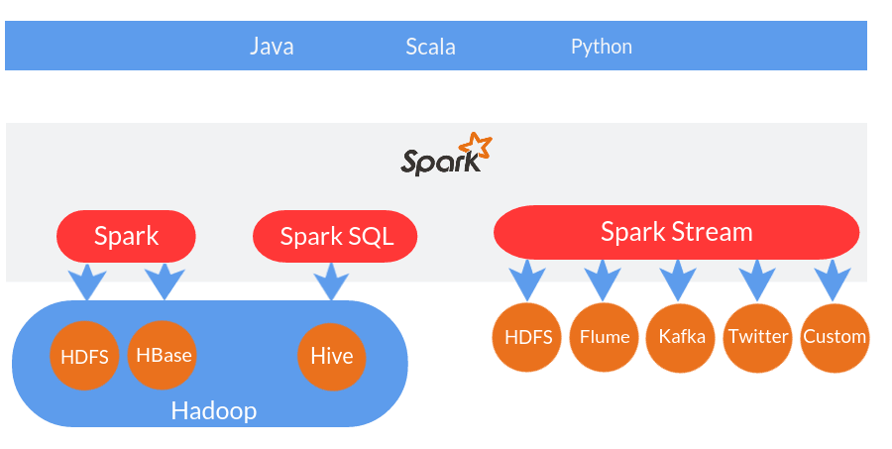
Is Apache Spark going to replace Hadoop? Yes its possible . Hadoop is parallel data processing framework that has traditionally been used to run map/reduce jobs. These are long running jobs that take minutes or hours to complete. Spark has designed to run on top of Hadoop and it is an alternative to the traditional batch map/reduce model that can be used for real-time stream data processing and fast interactive queries that finish within seconds. So, Hadoop supports both traditional map/reduce and Spark. Spark uses more RAM instead of network and disk I/O its relatively fast as compared to hadoop. But as it uses large RAM it needs a dedicated high end physical machine for producing effective results For more details refer below link http://aptuz.com/blog/is-apache-spark-going-to-replace-hadoop/

Slide 7
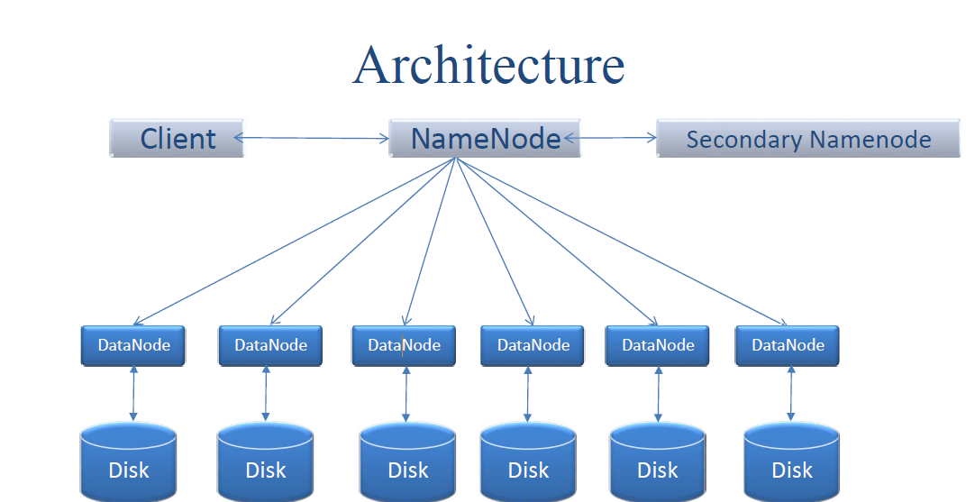
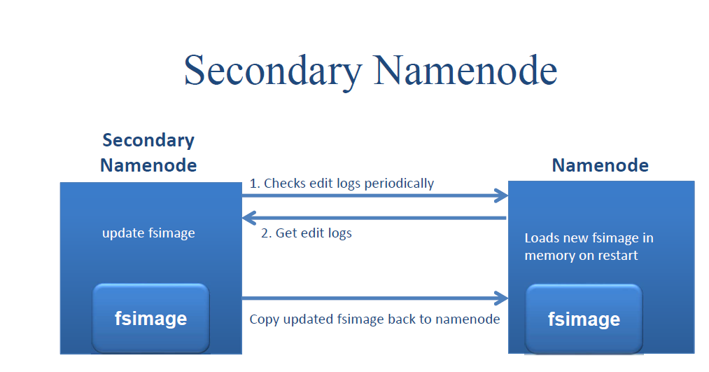
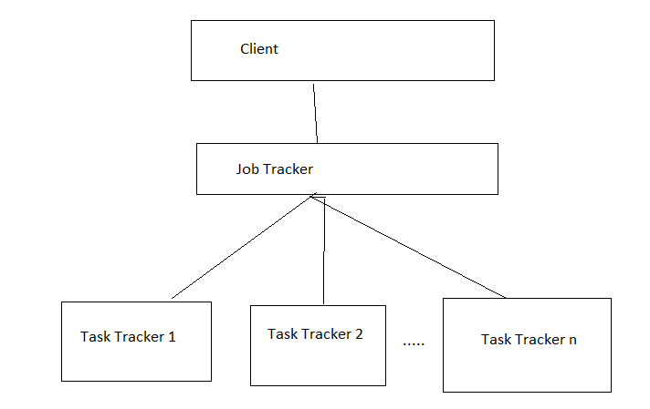
Hadoop Architecture mainly Hadoop architecture is divided into HDFS And Map-reduce . In HDFS Main components divided into Namenode , secondary namenode ,

Slide 8
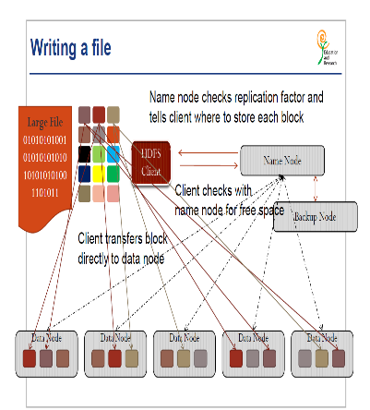
Writing/Reading File in HDFS

Slide 9
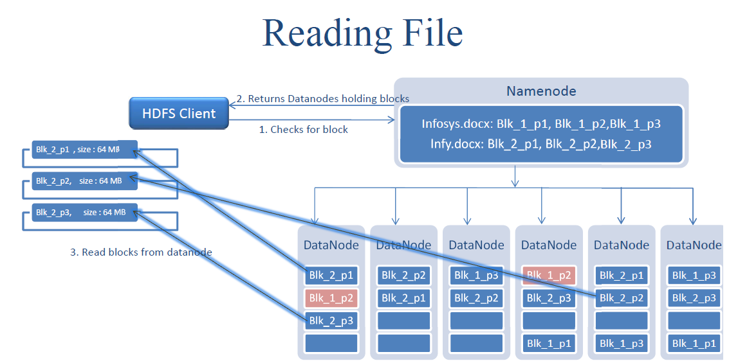

Slide 10
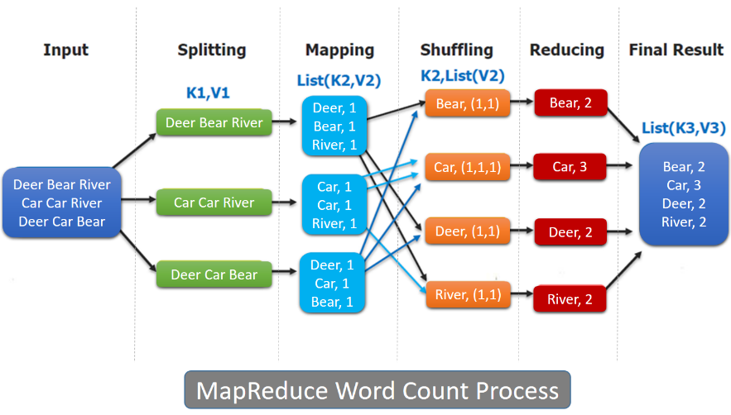
Map Reduce

Slide 11
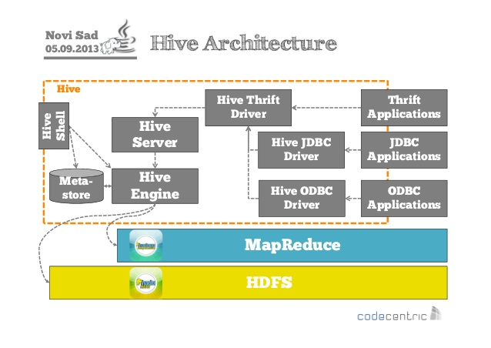
Hive Architecture

Slide 12
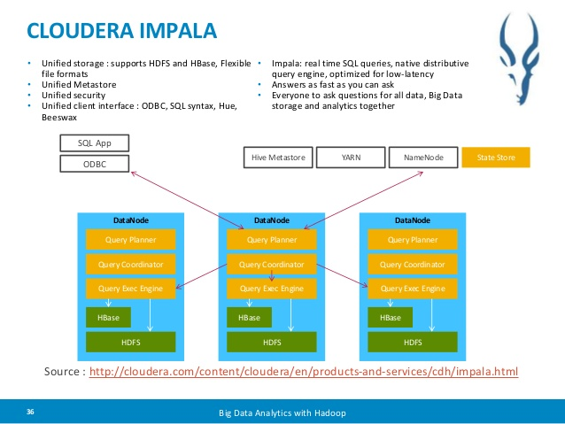
Impala

Slide 13
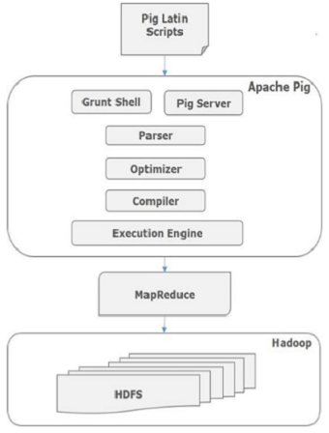
Pig

Slide 14
Apache Hadoop
HDFS: Hadoop Distributed File System. Scalable, distributed, fault tolerant data storage
YARN: Resource management framework for MR2 and Spark
Components of Hadoop Ecosystem is :
Data ware House – Hive
Processing Large Data – PIG
Data Base Migrator – Sqoop
Logs/sensors data Extraction – Flume
Other Unstructured data Extraction -- Chukwa
Cluster Coordinator – ZooKeeper,
MapReduce: MapReduce is a programming model for processing large data sets with a parallel, distributed algorithm on a cluster. Apache MapReduce was derived from Google MapReduce
HDFS Cluster : A machine will be called as cluster if that machine has HDFS and MapReduce Software’s installed
Apache Hive (HiveQL): Metadata repository with SQL-like interface and ODBC/JDBC drivers for connecting BI applications to Hadoop. For DDL && Select Delete ,Truncate it is same as other SQL developer toll but for Few DML(Insert/Update) statements we have to use assemble language like load data from this path. Here we don’t have any TCL statements data will be committed automatically. Here Logs will come in Java Language when we run Hive commands In SQOOP and by using we can understand map-reduce job statues.
Useful for Data warehouse applications to analyse static data.
It will not support record level insert/update/delete statements.
Apache Impala: Real-time, SQL-based query engine for data stored in HDFS
All SQL Queries Loading/running is same as Oracle. Here Logs will come in Java Language when we run Impala commands In SQOOP and by using we can understand map-reduce job statues
Apache Pig: Pig Latin Language-based query engine for data stored in HDFS
Pig Latin Language is like Assemble Language (high level language). Here all logs will come in Pig Latin language and it internally converts pig Latin language to System Understand language.
Apache Oozie: Workflow engine to coordinate Hadoop activities. It’s like Control/decision making language. We have to write code in xml language. By using this we can run list/bunch of Hive & Impala & Pig Queries. It is like Scheduler in Oracle Language to create and track job statues.

Slide 15
Apache Sqoop: Data transport engine for integrating Hadoop with relational databases. Here Import Means (Import a table from a database to HDFS) data is transferring from ORDBMS→ HDFS.
Export Means (Export an HDFS directory to a database table) data is transferring from HDFS -> ORDBMS
Apache Sentry: Provides fine-grained, role-based authorization for Impala and Hive
Apache Zookeeper: Highly reliable distributed coordination service
Cloudera Hue: Browser-based desktop interface for Hadoop
Cloudera Navigator: Addresses data security concerns most typically associated with highly regulated industries such as financial services, healthcare, and government. It includes a full suite of auditing capabilities across all CDH components that store data
Apache HBase Distributed, scalable, key-value store for random, realtime read/write access to data stored in Hadoop. It’s No SQL Database.
Apache Spark Fast and general engine for large-scale machine learning, interactive analysis, and streaming analytics over large datasets.
Cloudera Backup and Disaster Recovery (BDR) Integrated, easy-to-use management solution for enabling data protection in the Hadoop platform.
Cloudera Search Full-text, interactive search, and scalable indexing on Apache Hadoop and Apache Solr.
Cloudera Oryx Realtime, large-scale machine learning and predictive analytics infrastructure.

Slide 16
Apache Oozie: Workflow engine to coordinate Hadoop activities. It’s like Control/decision making language. We have to write code in xml language. By using this we can run list/bunch of Hive & Impala & Pig Queries. It is like Scheduler in Oracle Language to create and track job statues.
Apache Sqoop: Data transport engine for integrating Hadoop with relational databases. Here Import Means (Import a table from a database to HDFS) data is transferring from ORDBMS→ HDFS.Export Means (Export an HDFS directory to a database table) data is transferring from HDFS -> ORDBMS
Apache Sentry: Provides fine-grained, role-based authorization for Impala and Hive
Apache Zookeeper: Highly reliable distributed coordination service
Cloudera Hue: Browser-based desktop interface for Hadoop
Cloudera Navigator: Addresses data security concerns most typically associated with highly regulated industries such as financial services, healthcare, and government. It includes a full suite of auditing capabilities across all CDH components that store data

